Slide 1

Global vs. Local Perspectives on Endangerment
Rarity vs. endangerment and the role of environmental scale, genetics, dispersal barriers and range limits.

Slide 2

Excerpt from: Endangered Species, Provincialism and a continental approach to Bird Conservation:
Extinction is a lucidly chilling concept for researchers who have worked with endangered bird species. This concept of endangerment has in recent decades been extended to include species that are subject to regional extirpation. However, designations of endangerment at the local level may be strongly influenced by local perceptions. For example, conservationists in the midwestern United States, among others, have documented the agriculture-related fragmentation of their forests and its negative effects on bird species richness and the ability of forest bird species to sustain themselves in such systems. Conversely, northeastern U.S. researchers have noted the expansion of forest at the expense of birds that were largely associated with disappearing agricultural and other anthropogenic landscapes. Although such perspectives may highlight important regional concerns in need of conservation action, they might also yield local conservation assessments that neither reflect nor contribute toward resolving larger continental conservation issues.

Slide 3
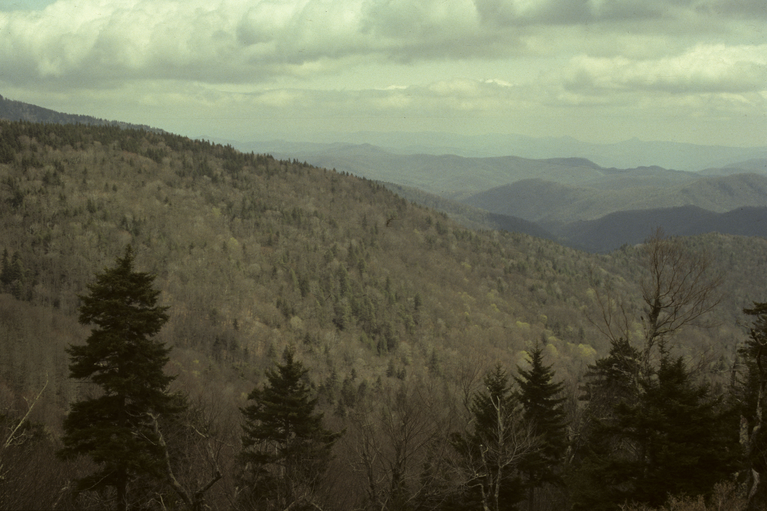
Objectives
To clarify rarity vs. endangerment.
To understand how environmental scale relates to considerations of endangerment.
To consider the role of genetic issues with respect to species distributions.
To evaluate complex considerations in drawing conclusions about conservation status.

Slide 4
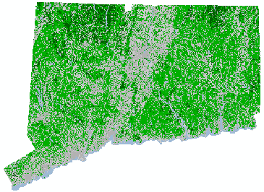
Endangered Classification at the Local Level
Each state has developed its own list of at risk species, using a classification similar to the federal ones.
In Connecticut, the categories are State Endangered, State Threatened and Species of Special Concern.
Generally, the northeastern and west coast states interpret species statuses liberally and have large state lists, whereas western and southern states do so more conservatively and have shorter lists.
Many states differentially focus conservation concern on species that are rare within state boundaries but that exhibit low global concern.
In addition to state lists, The Nature Conservancy has developed a tiered classification scheme called NatureServe. It ranks status at the global, national and state level from 1 to 5 (highest to lowest priority).
The International Union for Conservation of Nature produces a Red List, which similarly categorizes species.
Like all states, Connecticut maintains and updates a list of species of conservation concern.

Slide 5
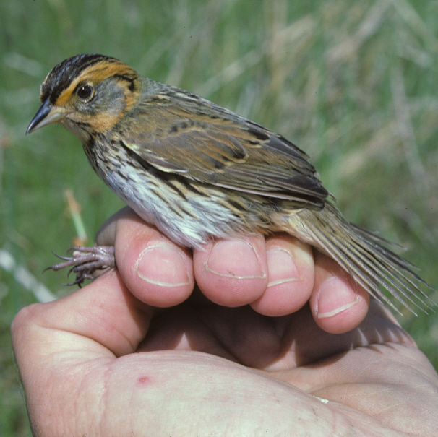
Case study: the Saltmarsh Sparrow
The species is restricted to salt meadow habitat found in coastal marshes inundated regularly by salt water.
Although abundant within preferred habitat, continental populations have declined as salt meadow habitat has been lost.
It occurs abundantly in this habitat along the Connecticut River estuary in the town of Old Lyme, CT.
Salt meadow begins to drop out further upriver in the less brackish river marshes in the town of Lyme, so the species occurs only rarely there.
Should the town conservation commission of Lyme then declare it endangered in this town?
What environmental scale is appropriate to use in designation of endangerment?
How do local vs. range-wide populations influence consideration of endangerment?

Slide 6
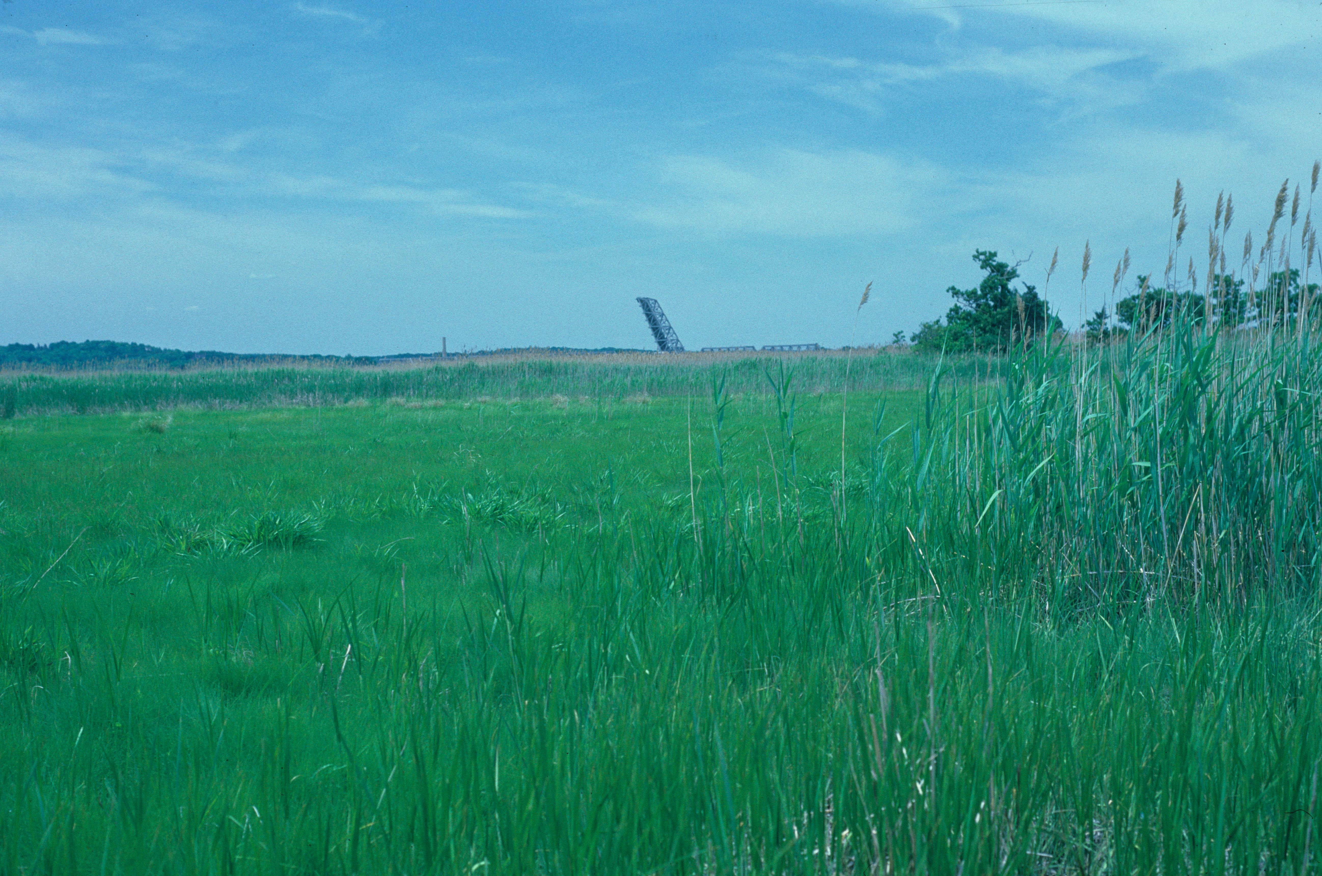
Rarity vs. Endangerment
This is the Lyme portion of the Connecticut River estuary- a region dominated by reeds and cattails but with scattered patches of salt meadow.
Populations of Saltmarsh Sparrows here are part of a larger metapopulation- populations separated geographically but in contact via dispersal between areas.
Populations in these small, suboptimal habitats are likely to be sink populations, whereas those of the extensive salt meadows downriver are source populations.
These populations illustrate the folly of using arbitrary political boundaries for developing conservation policy.
Local rarity can be related to the underlying dynamics of population/ habitat interactions and have nothing to do with conservation concern.
To assess conservation concern, one must understand a species’ population dynamics, habitat relationships, continental population trends and causes of population change.
In this case, there is a legitimate cause for concern, but for the species as a whole.

Slide 7
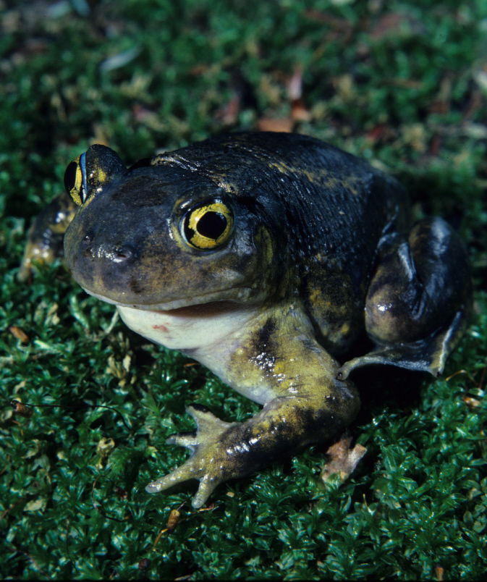
When Local Populations Matter
Birds are excellent dispersers because of their ability to fly between populations and over unsuitable habitat. But how about species with poor dispersal ability?
Case study: the Eastern Spadefoot.
  This amphibian is widespread and abundant on the eastern coastal plain from Long Island to Florida, where it breeds in vernal pools.
  At the close of glacial times, extensive sandy moraines deposited across eastern Massachusetts, Rhode Island and eastern Connecticut approximated coastal plain conditions, so the species colonized when Long Island was still contiguous with New England.
  These populations are now disjunct and consist of relict populations- those that are isolated and remaining from an earlier time.
Connecticut Eastern Spadefoot

Slide 8
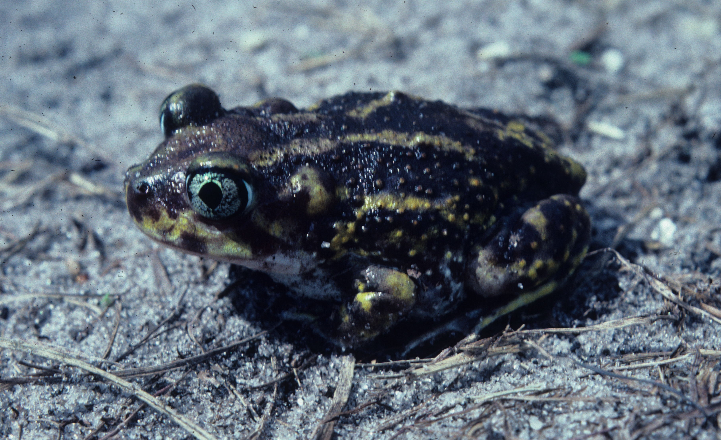
Local Populations- continued
New England populations have been isolated for at least 6,000 years; i.e. there is no gene flow between this and coastal plain population.
Over time, genetic change occurs in isolation via genetic drift, founder effect and natural selection acting to produce adaptations.
Hence, New England individuals may be considered to be evolving into a new species.
This means that even though the species as a whole is abundant and widespread, this population at the northern range limit has evolutionary consequence.
Spadefoot populations in New England are also rare and under threat from habitat loss.
In this instance, a local population may be considered to be of conservation concern, demonstrating that history is also a criterion in assessing endangerment.
This coastal plain Eastern Spadefoot distinctly differs from New England individuals.

Slide 9
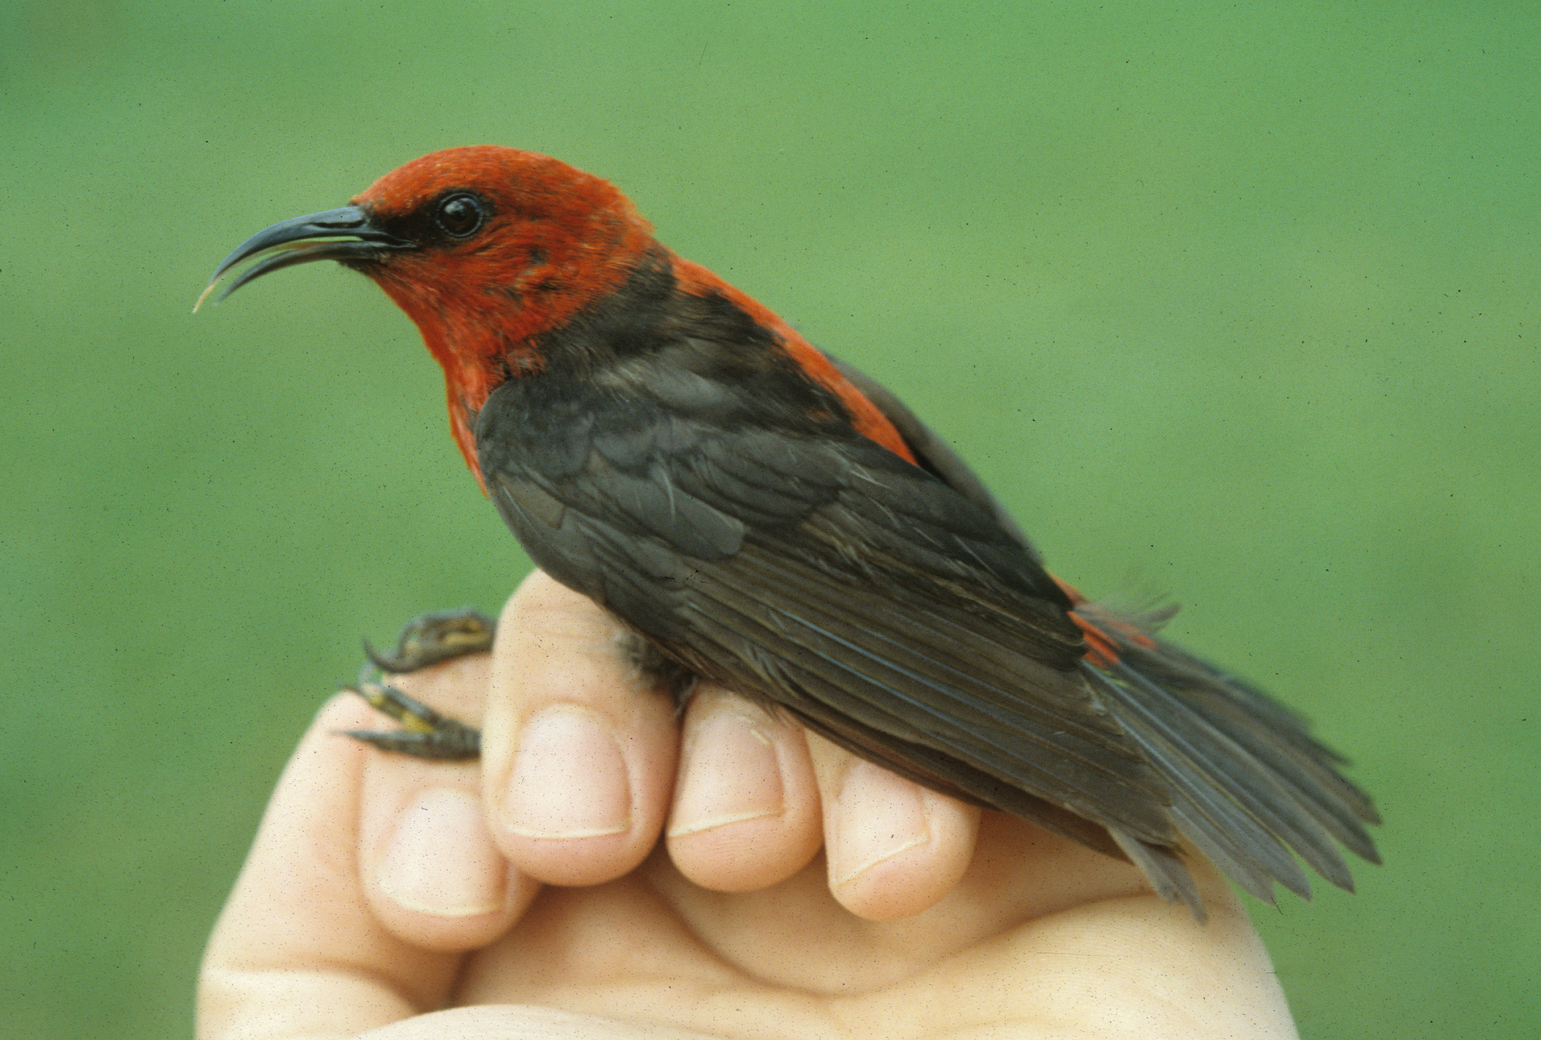
Barriers to Dispersal
Even for good dispersers like birds, certain barriers can isolate populations.
The quintessential examples are populations of land birds on oceanic islands. Inter-island dispersal is rare, so when islands are colonized, populations diverge over time.
Case study: Micronesian Honeyeater
  Populations living in identical habitat on adjacent Pacific islands just miles apart appear the same in appearance and voice, but measurements of the birds diverge statistically.
  Although the degree of isolation is not as great as with the Eastern Spadefoot, minimal gene flow between populations is enough to yield populations that may be expected to become increasingly distinct over time.
  This phenomenon is what has led to high rates of endemism among island organisms.
Micronesian Honeyeater
Aguiguan Saipan
Mean bill length (mm): 11.4 12.5

Slide 10
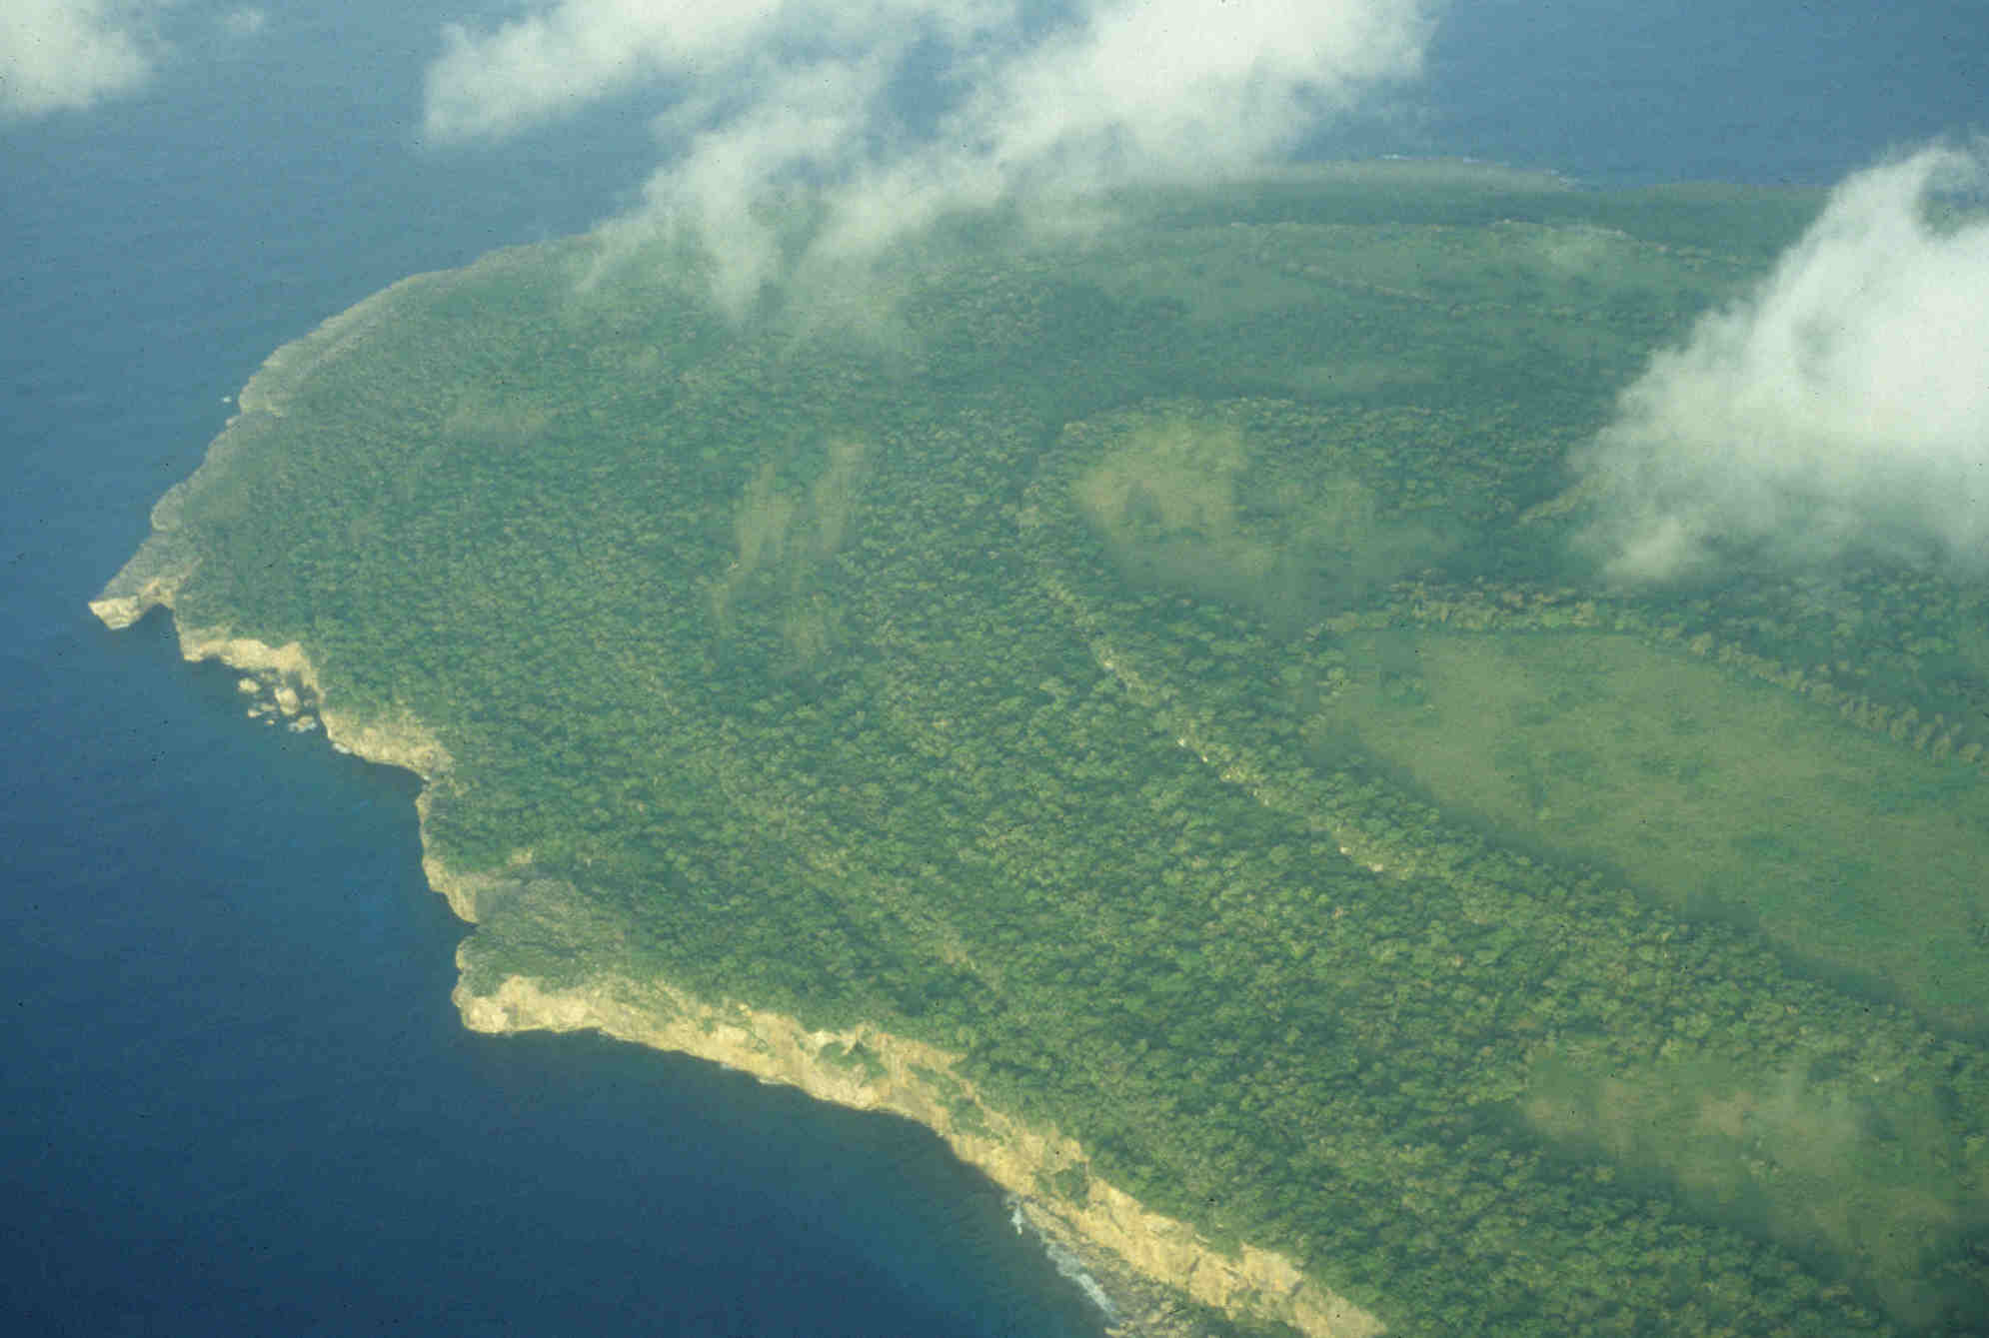
Barriers- continued
Among good dispersers, we must consider the circumstances of the population in considering the degree of conservation importance.
Even on uninhabited Aguiguan Island (background), where Micronesian Honeyeater numbers are large and stable, it is appropriate consider this population to be of conservation concern because:
  The population is restricted to this small island,
  It may be an incipient endemic species that is:
  vulnerable to density-independent effects like supertyphoons,
  vulnerable to density-dependent effects like introduced disease and predators,
  vulnerable to human-associated habitat change and habitat degradation.

Slide 11
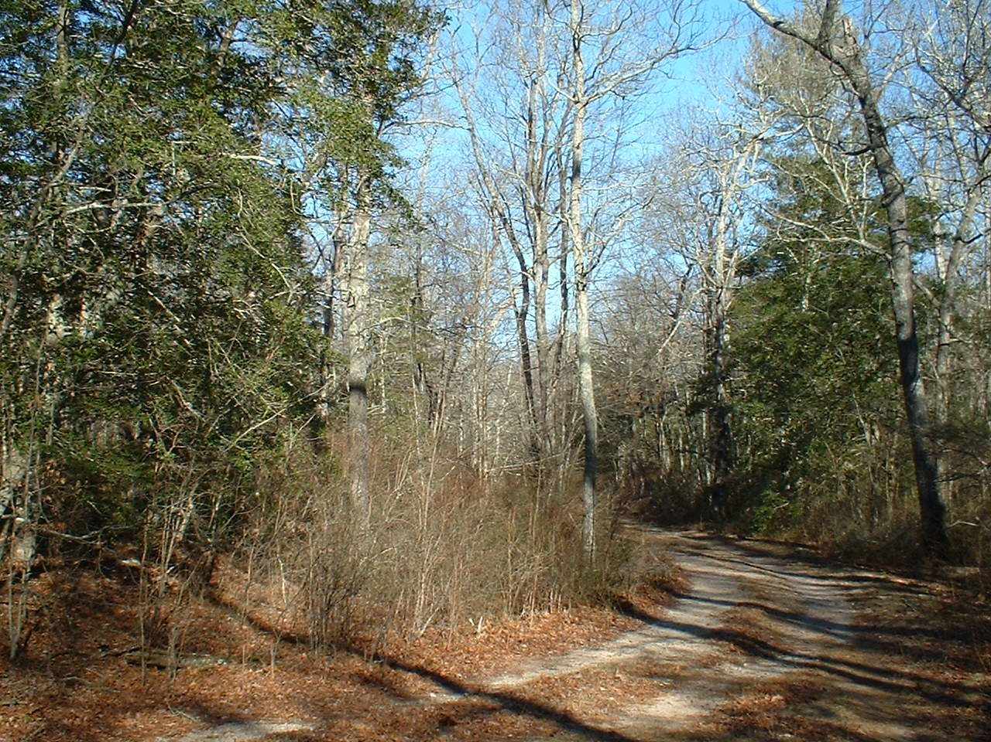
Range Limit Considerations
What are the conservation considerations of species at range limits that have a continuous range?
Case study: American Holly
  Like the Eastern Spadefoot, American Holly colonized southern New England after glacial times when climate moderated to approximately present conditions- ca. 6,000 years ago. Historically, it has been very local in occurrence along the coast.
  Its northern range limit is determined by a physiological factor- minimum winter temperatures. North of the coast, the tree does not set viable seeds.
  Fruits are dispersed by land birds, which concentrate on the coast during migration, so it is reasonable to assume that significant gene flow still occurs between coastal New England, Long Island and points south.
The evergreen American Holly is near its northern range limit in coastal Rhode Island.

Slide 12
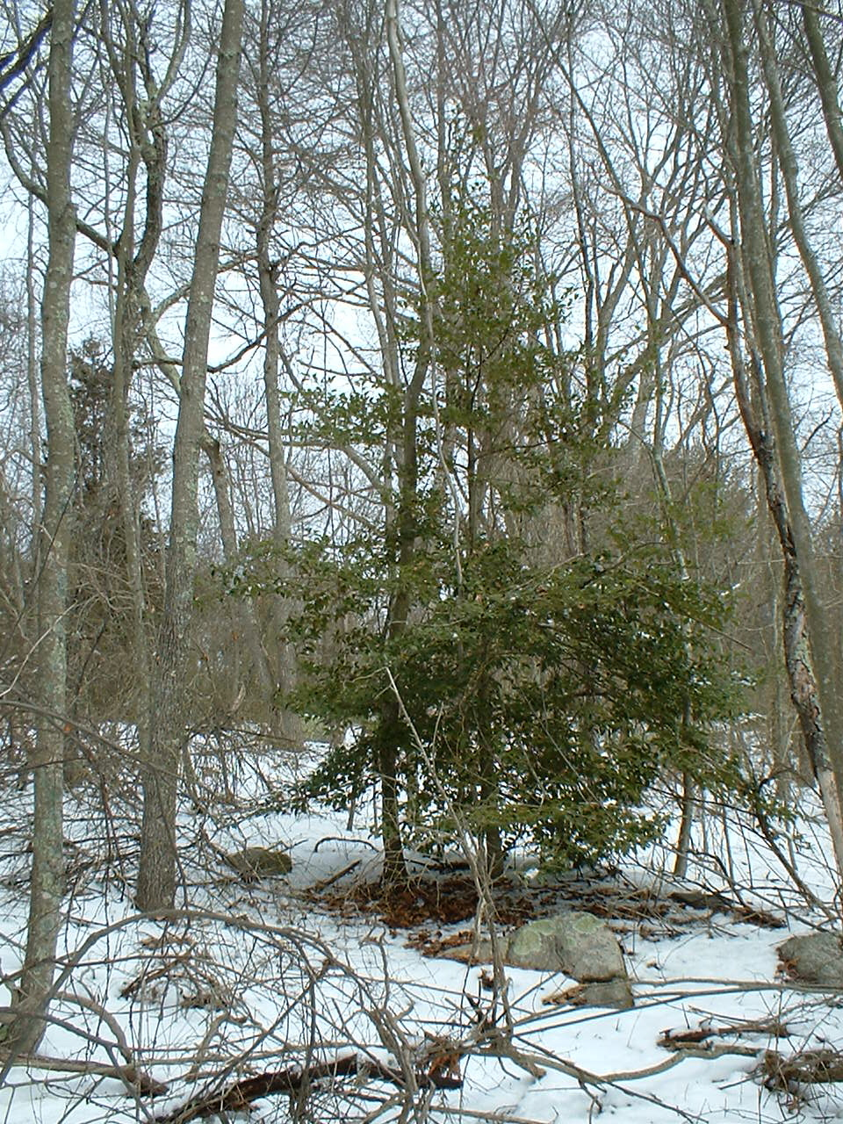
Range limit-continued
Although it is rare in southern New England, should it be considered to be of conservation concern, as it is likely not very genetically distinct from populations that are widespread and abundant?
A north-south cline in traits likely exists, as this is typical for widespread species.
The marginal conditions at the range limit select for traits that are adaptive there. Indeed, northern populations of plants are often more winter-hardy than southern populations.
Hence, range limit populations may be expected to be at the vanguard of adaptations that can lead to range expansions.
Seedling hollies are now appearing miles inland from where they did in the 1970s. Much of this northward range expansion is likely related to a warming climate, but adaptation also may be playing some role.
So, range limit populations may be thought of as a critical part of a species genetic reservoir and, hence, of significant conservation concern.
Holly seeds are now successfully germinating further inland.

Slide 13
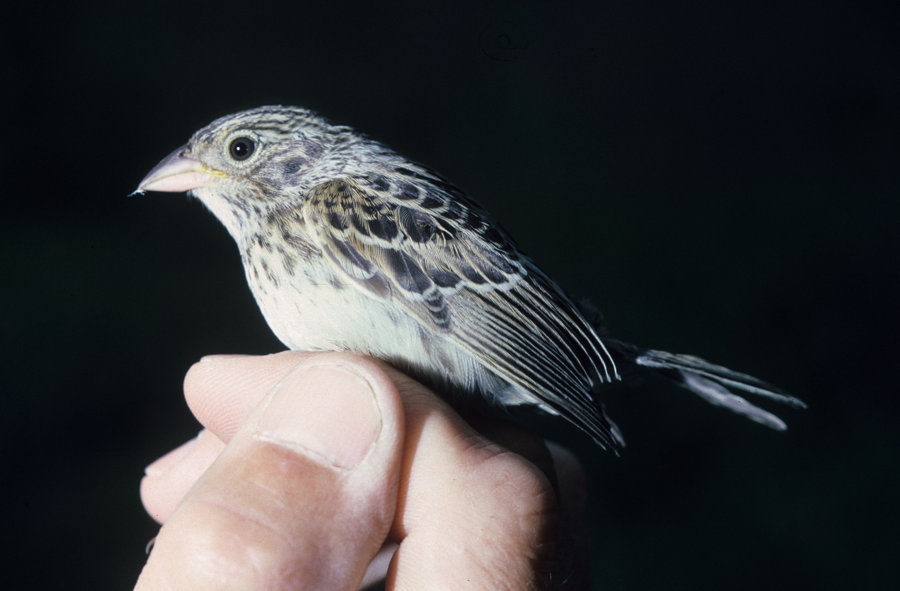
Additional Considerations
As with most things in science, the more closely one examines an issue, the more complicated and confusing it turns out to be.
Case study: northeastern Grasshopper Sparrow (right) populations.
  It is a widespread and common grassland species in much of its huge range.
  Despite being a good disperser, it exhibits significant genetic variation, such that it has been subdivided into distinct subspecies.
  Northeastern populations are now rare and locally-occurring, and this has raised concerns among conservationists.
  However, these populations are almost entirely associated with anthropogenic habitats.
  18th-19th century agricultural practices yielded extensive habitat that led to population expansion, but these habitat have now largely disappeared with changing land use.
The species appears capable of colonizing new habitats quickly, suggesting that remaining sink populations in the Northeast are maintained by source populations further west.

Slide 14
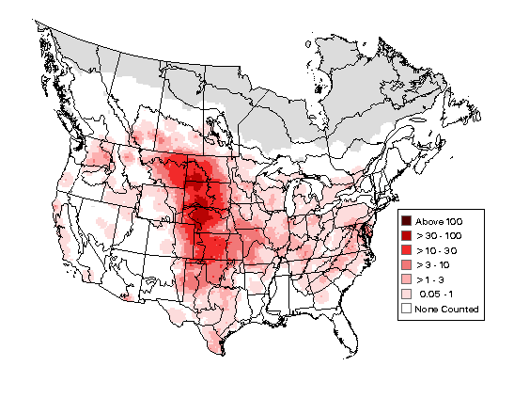
Additional Considerations- continued
Although northeastern populations exhibit genetic differences with others, such differences can appear quickly and may be related to the population’s 19th century range expansion.
When populations of other species have been translocated to new locations- like the Laysan Finch of the northern Hawaiian Islands- they diverged from their parent population within several generations.
So, at what point does genetic divergence equal conservation concern?
Relative population densities of the Grasshopper Sparrow based on Breeding Bird Survey data.

Slide 15
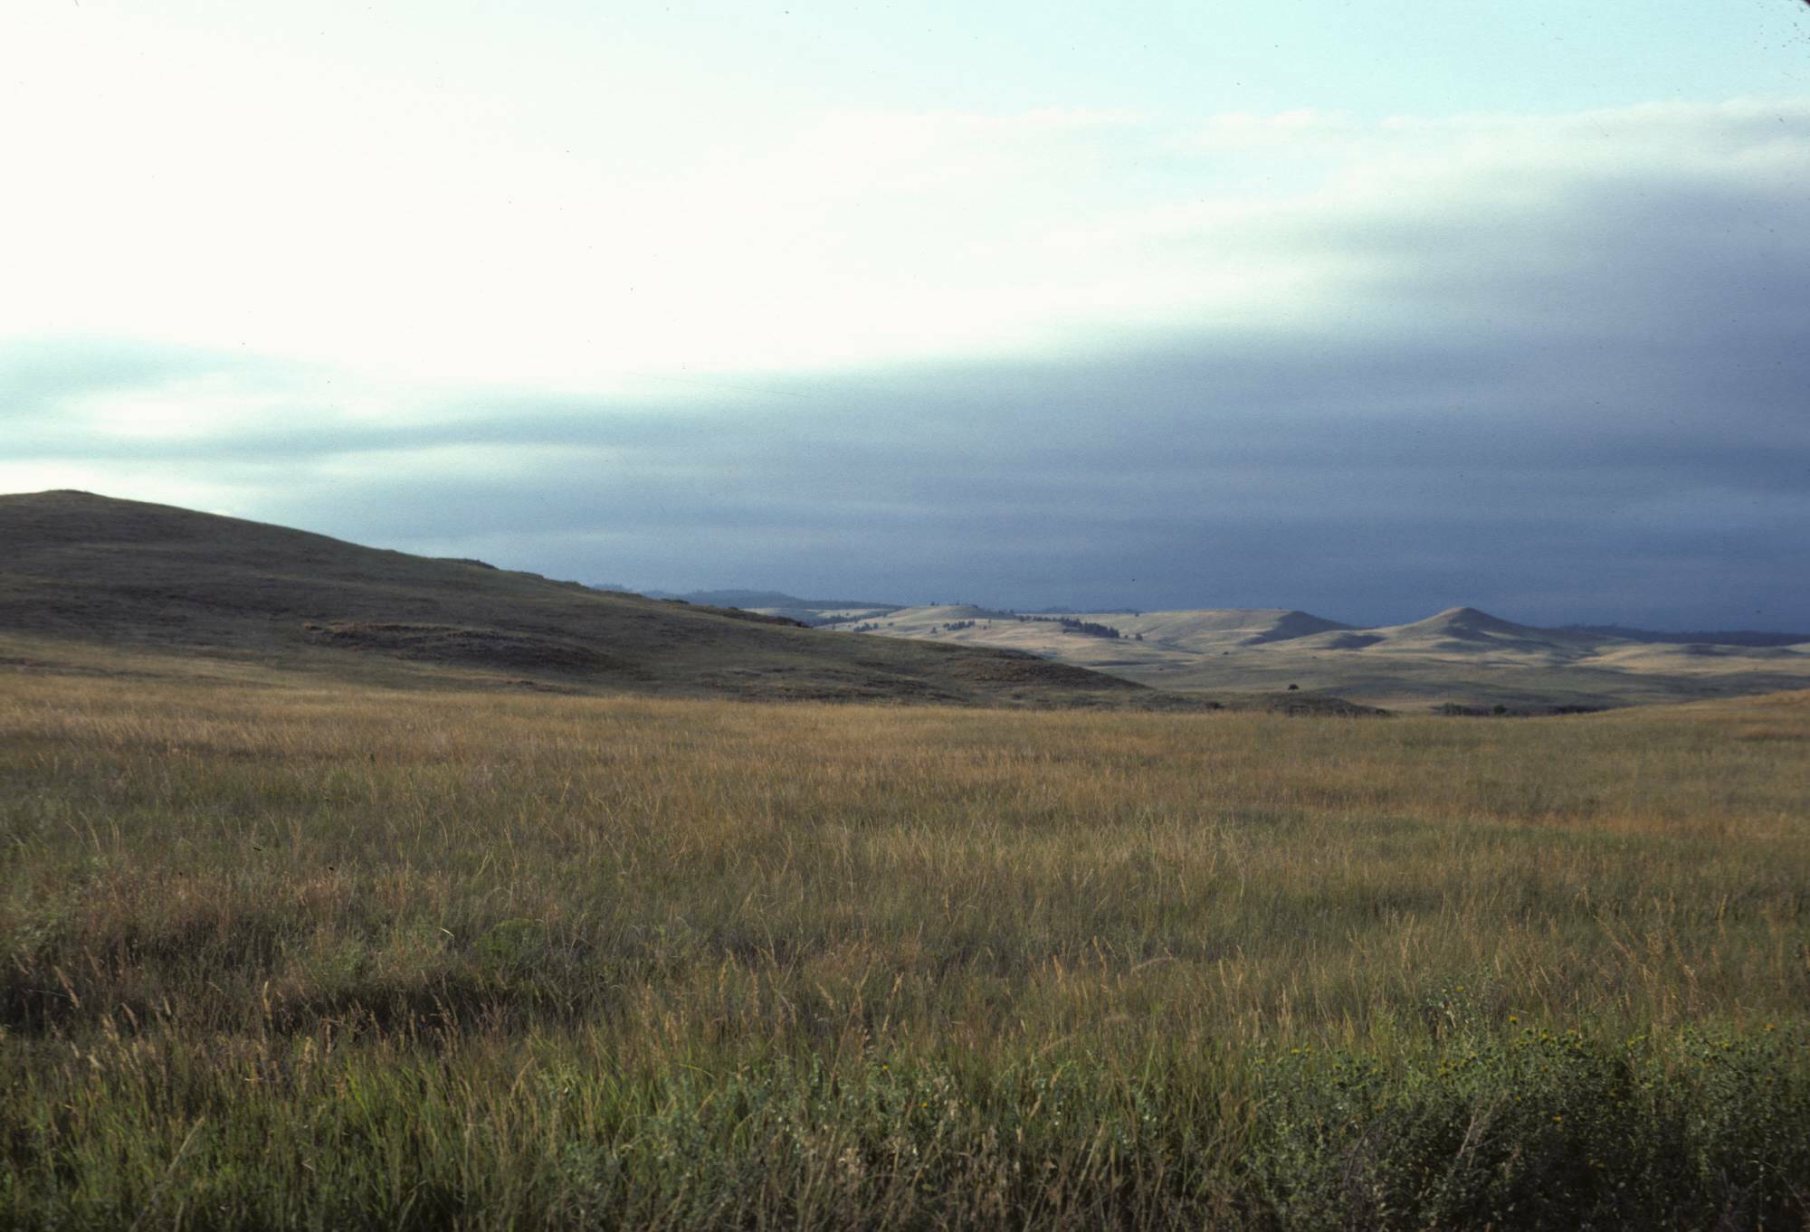
Practical Issues
The Grasshopper Sparrow clearly evolved as a grassland inhabitant and to this day its center of abundance is in the grassland provinces of North America.
Given that there are finite funds available to protect endangered species, should local conservation agencies in the Northeast use these funds to create artificial habitats that can support sink populations?
The North American landscape has historically been a dynamic one in which habitats invade regions and then recede from them. Shouldn’t we practice conservation based present habitat conditions rather than what they might have been at some time in the past, like the 19th century?

Slide 16

Excerpt from: Endangered Species, Provincialism and a continental approach to Bird Conservation:
This discussion has considered whether local assessments of species endangerment translate to conservation policies with significant impacts at the continental scale. Examples presented demonstrate that little substantive conservation contribution is likely to be achieved by focusing on peripheral species receiving endangered status by virtue of arbitrary state boundaries. Moreover, including such species can distract finite conservation resources from issues in which local efforts can yield substantive conservation results. Arguments used to justify conservation efforts on behalf of species termed here peripheral have weaknesses when considered in light of continent-wide population trends, geographic ranges, and historic distributions, as well as the historic dynamism of the North American environment and practical considerations about the present nature of continental environments. A continental perspective in approaching local conservation issues is advocated, where local efforts contribute to the solution of continental problems.

